Slide 1

The Coding connection
”Networking is not about just connecting people. It’s about connecting people with people, people with ideas, and people with opportunities!”
-Michele Jennae
Notes:
Welcome to the Coding Connection!
As Michelle Jennae once stated ”Networking is not about just connecting people. It’s about connecting people with people, people with ideas, and people with opportunities!”

Slide 2
Purpose/Motivation
To connect current students and recent graduates with a corporate recruiters currently hiring for positions that require the coding skills recently acquired from the bootcamp.
Notes:
Our purpose and motivation comes from our desire to connect current students and recent graduates with a corporate recruiters currently hiring for positions that require the coding skills recently acquired from the bootcamp.

Slide 3
Team Members
Shawanda Ford
Allison Haver
Fabian Byrd
Notes:
Our team consist of Shawanda Ford, Allison Haver, and Fabian Byrd.

Slide 4
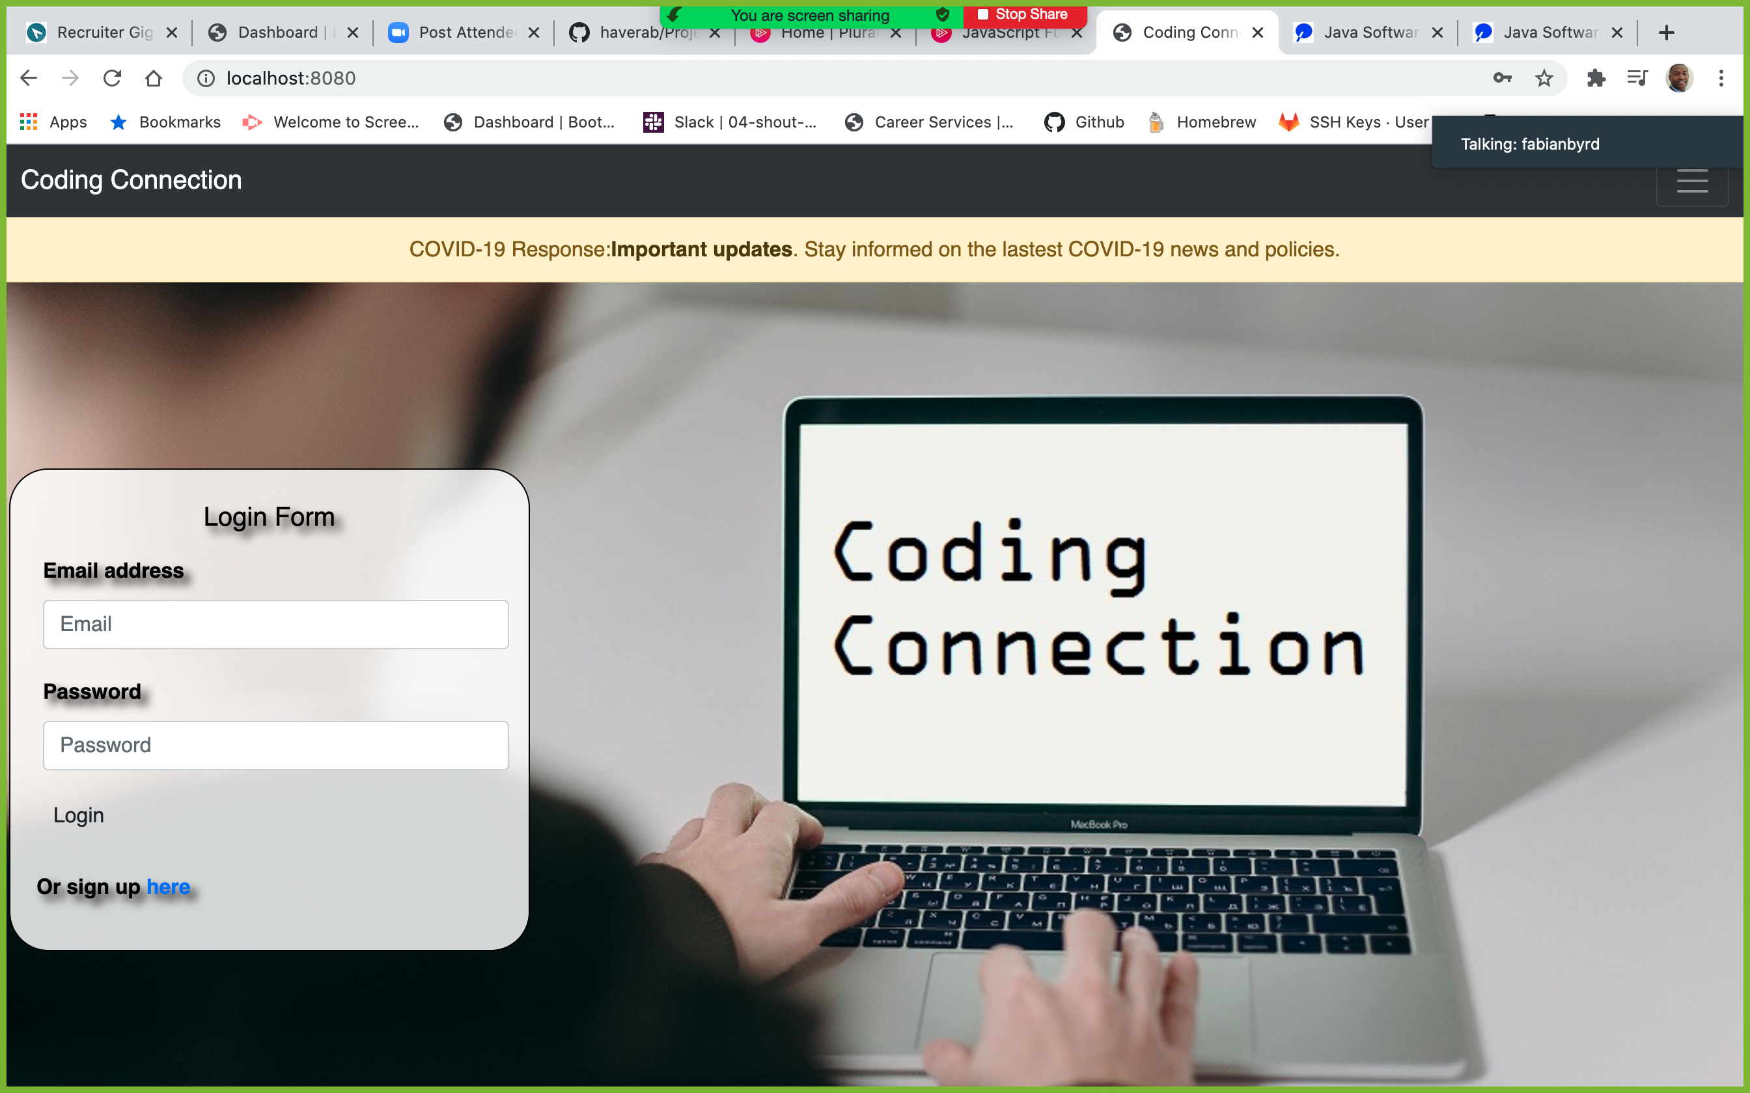
Team 2 Project 2
Notes:
Here you see our landing page where students and recruiter are allowed to login-in.
You will be also able to sign up for an account if you are not already a member.
Note: Please notice are banner where we brings attention to need to adhere to COVID-19 guidelines.

Slide 5
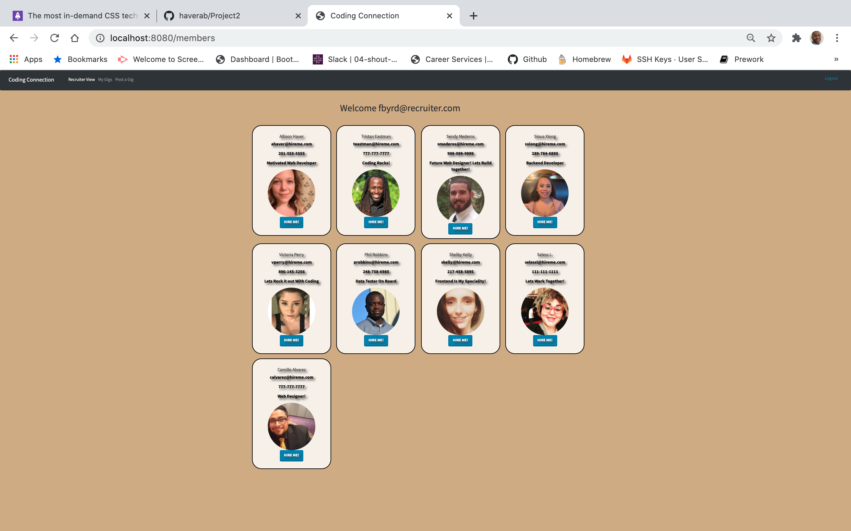
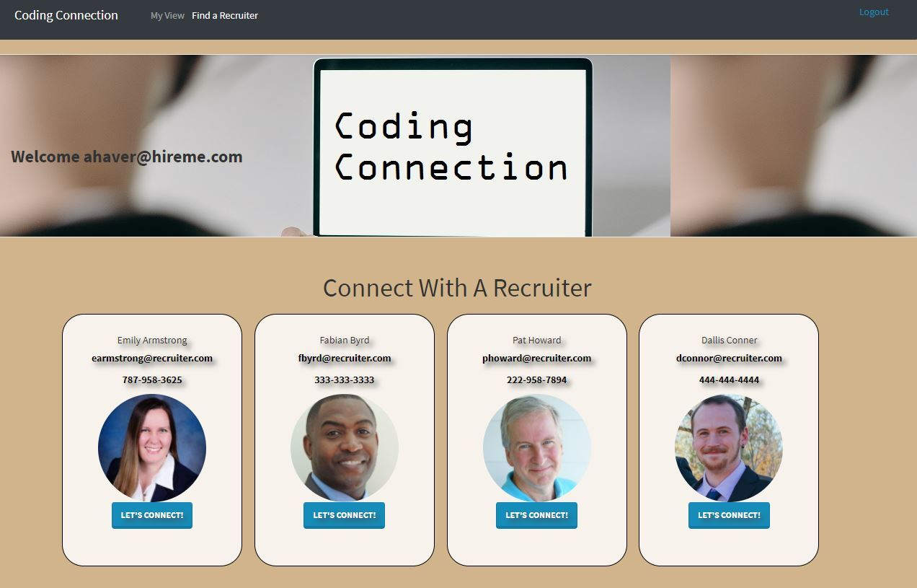
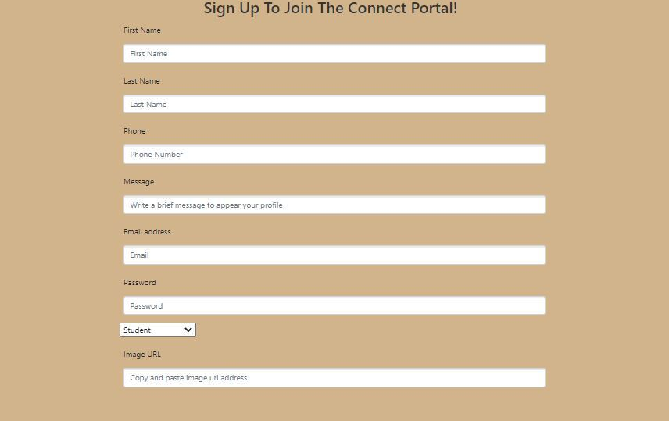
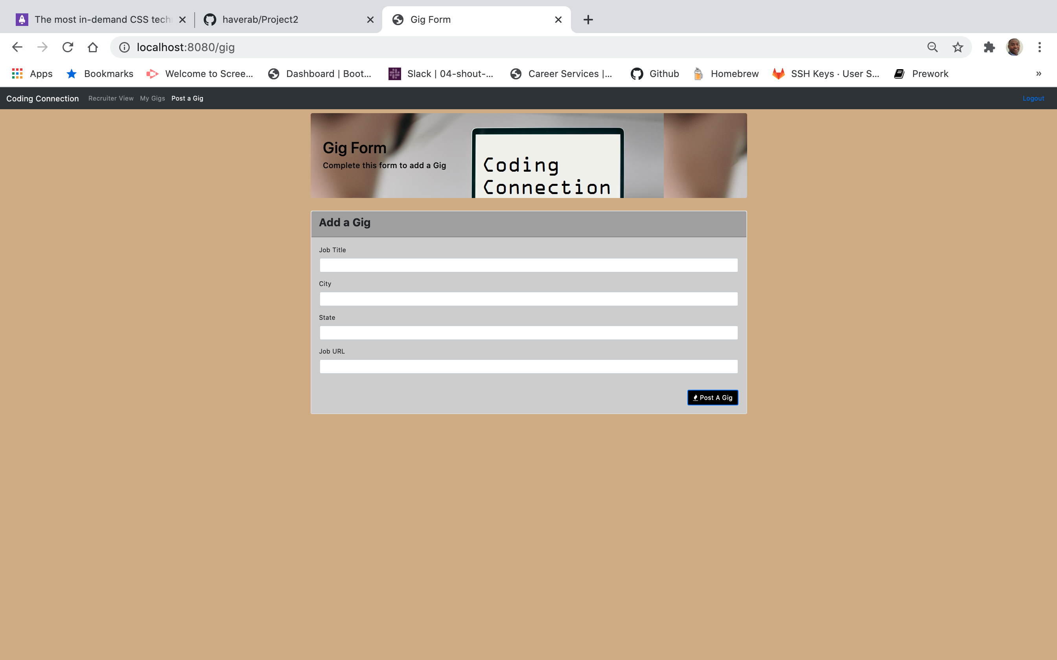
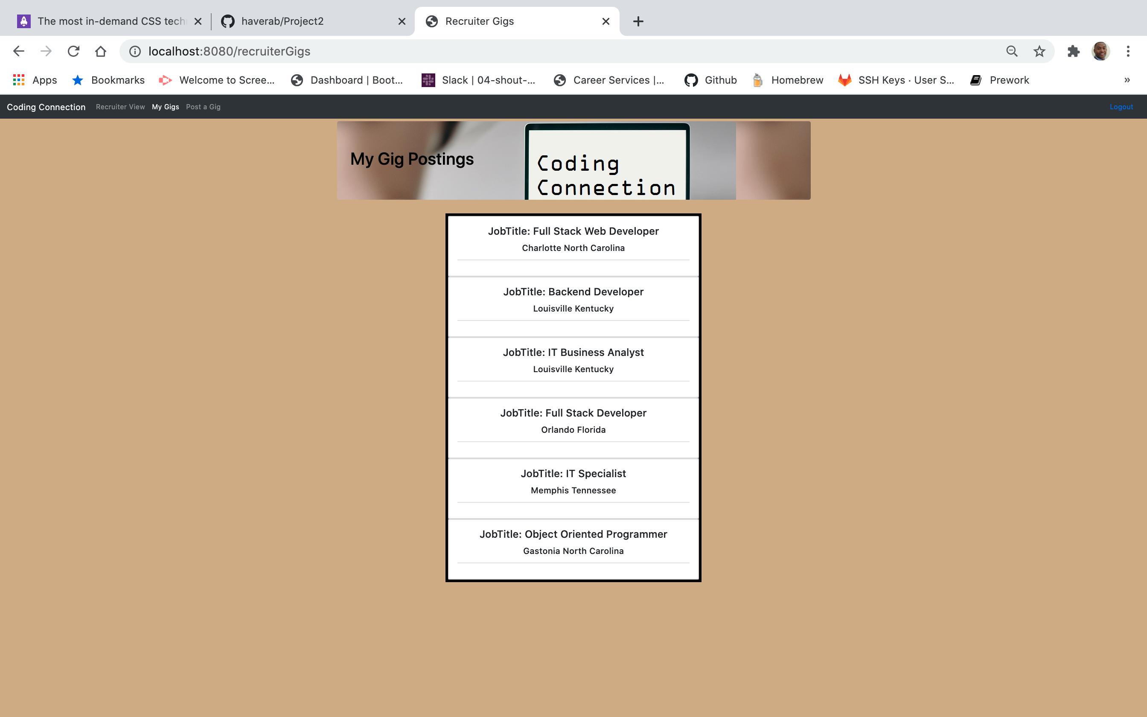
Polished Front End/UI
Landing Page
Recruiters View
Student View
Sign-up View
Initialize a Gig View
Gigs View
Notes:
To provide you with a snapshot of our polished front end user interface.
From left to right, you are able to see:
Landing Page
Recruiter View
Student View
Sign up View
Recruiter Gig Initialization View
Gig View
All of which will be demonstrated during our live demonstration.

Slide 6
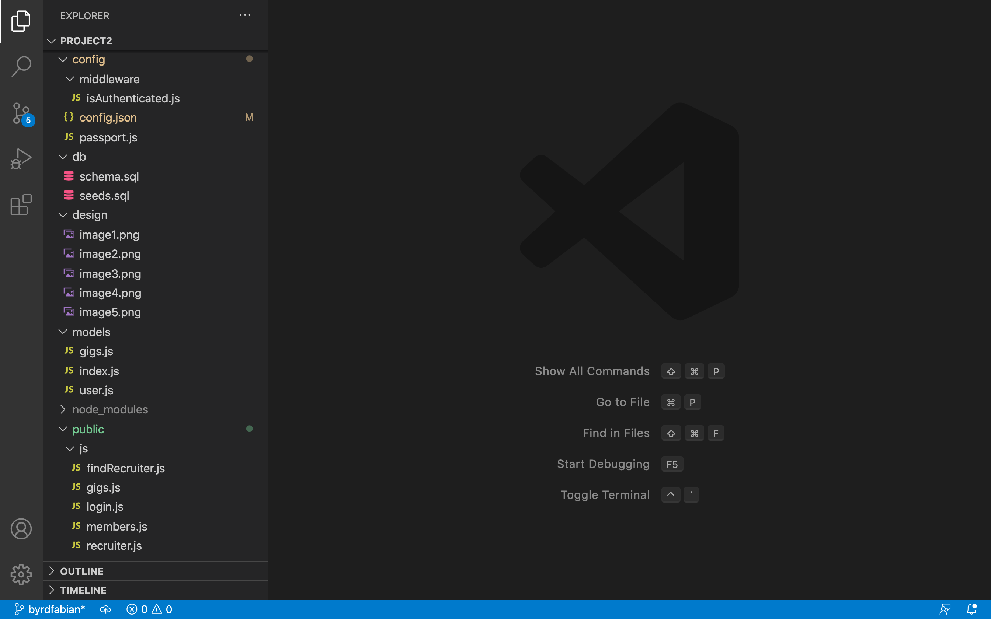
MVC Folder Structure
Notes:
Here you will see our MVC Folder Structure

Slide 7
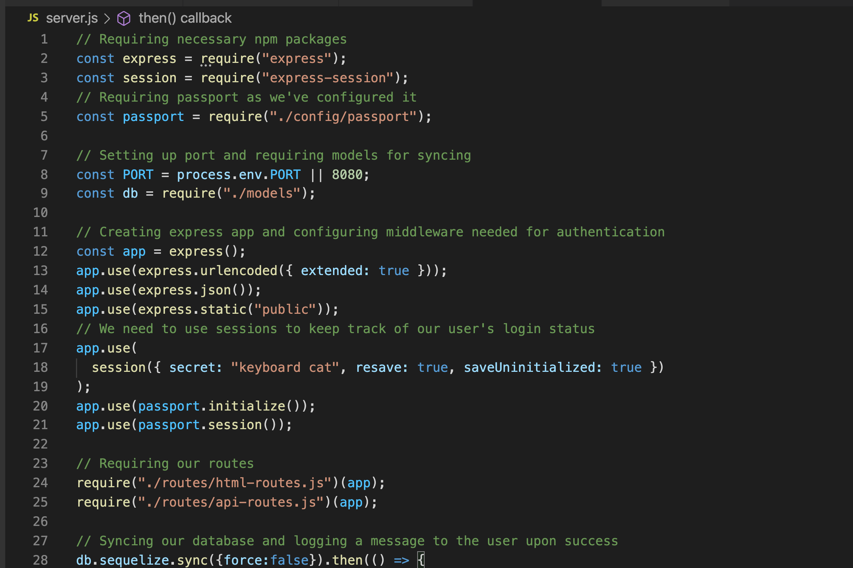
Node and Express Web Servers
Notes:
Here you will see the requirement to incorporate Node and Express Web Servers in our code.

Slide 8
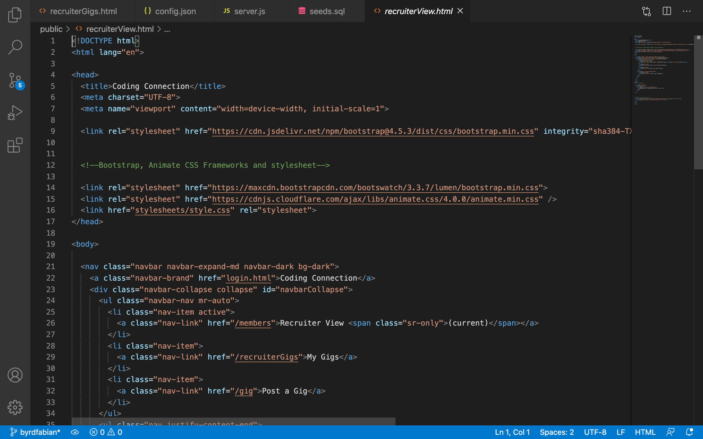
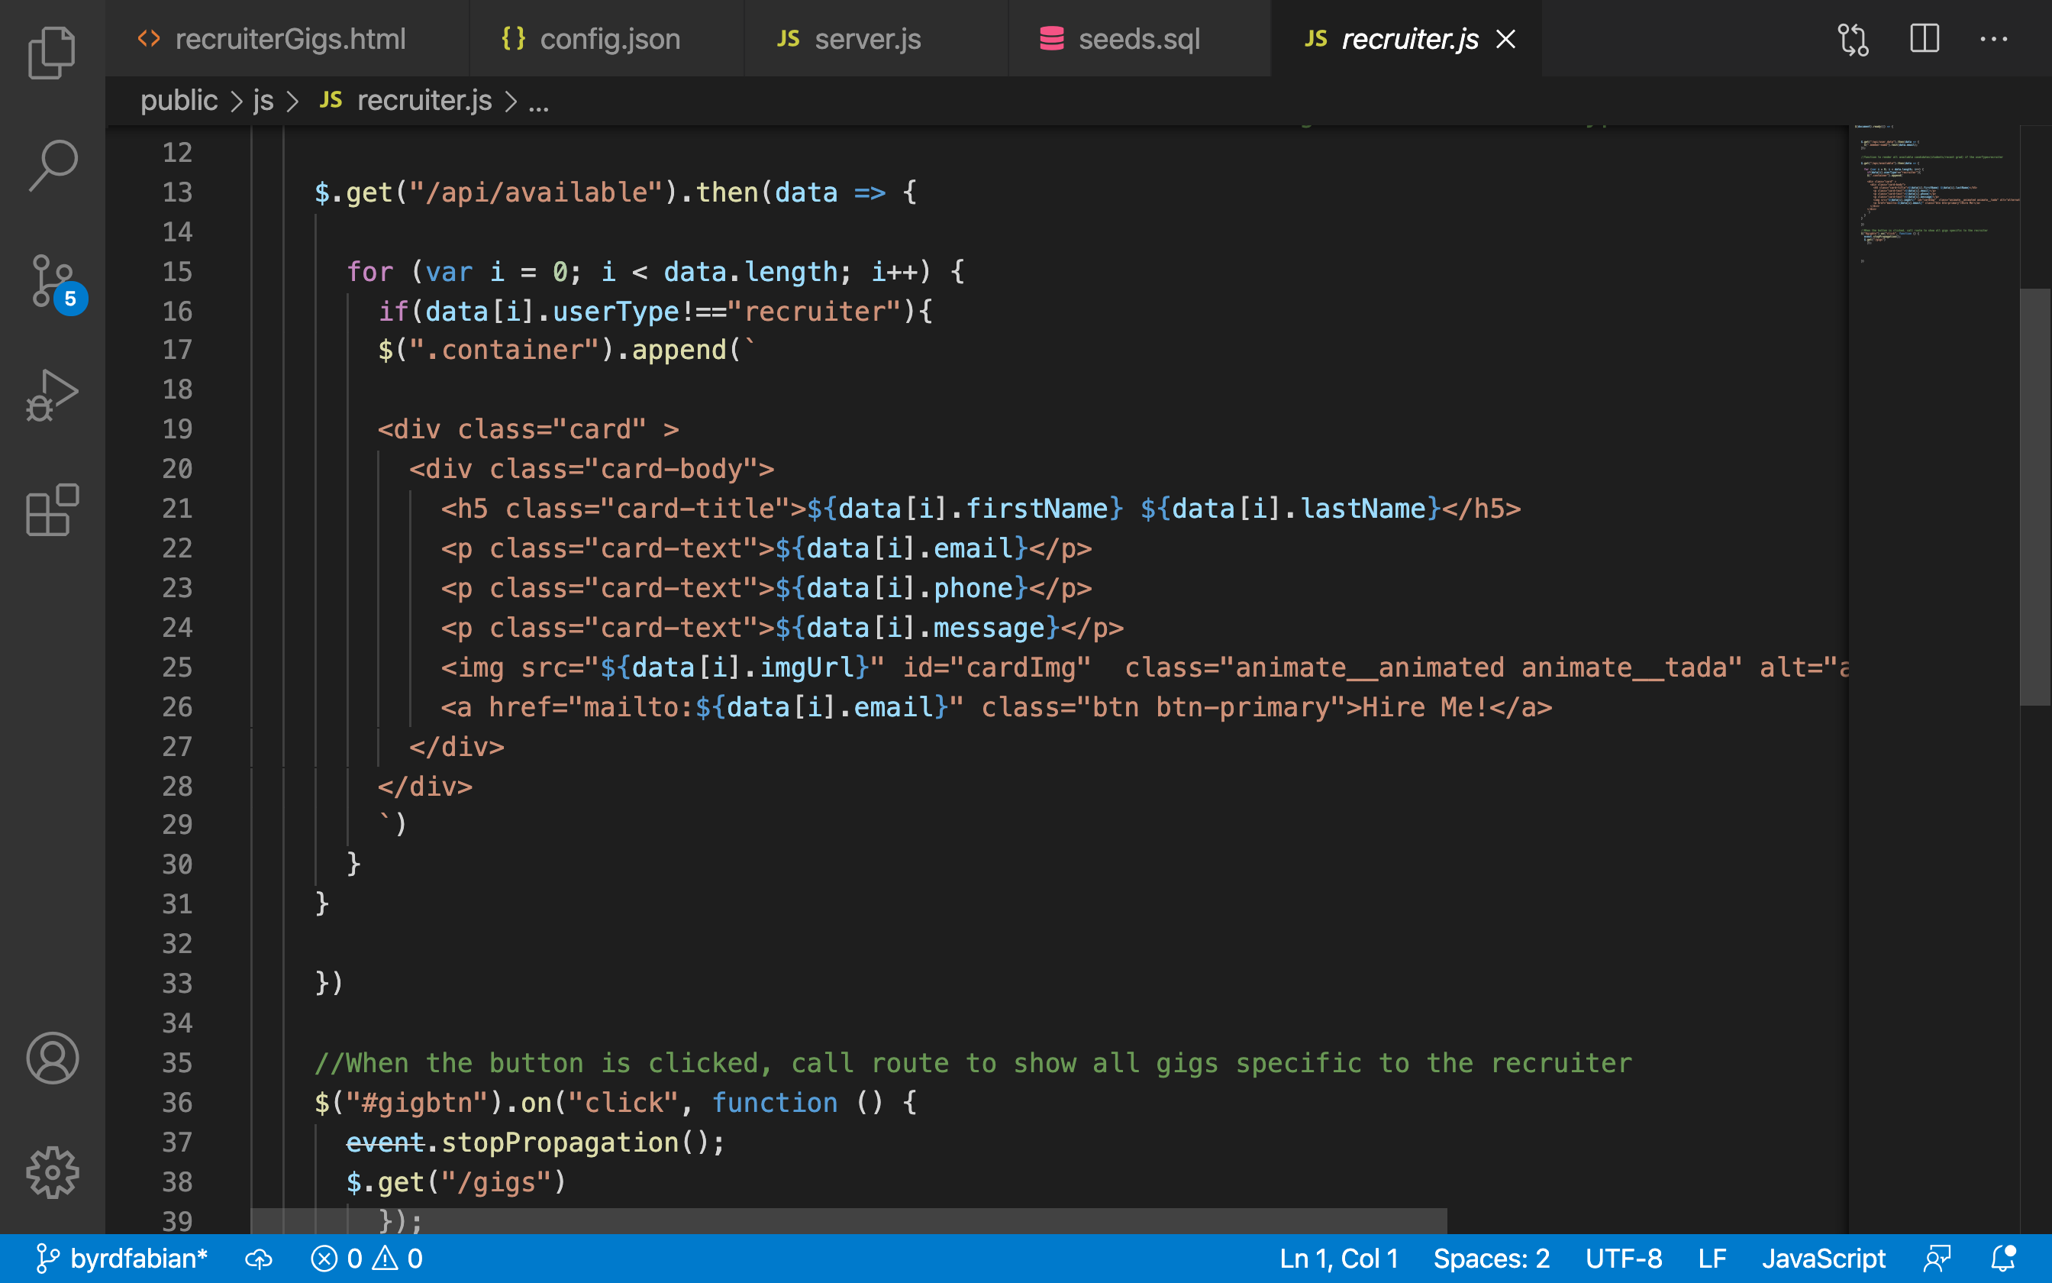
New Technology (CSS)
Notes:
The addition of new technology that we incorporated came with the use of CSS animation, where you will observe the added animation.
You will see this in action during our live Demonstration.

Slide 9
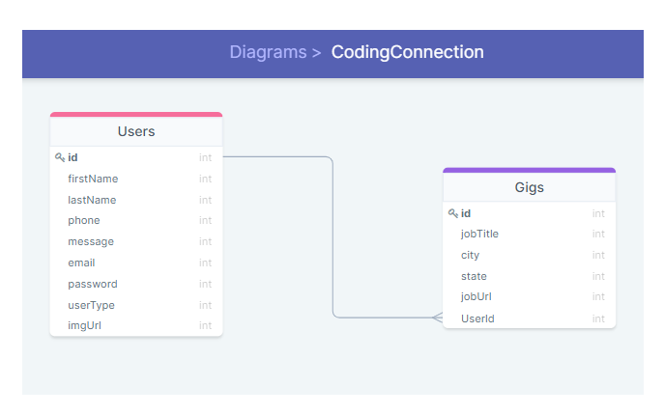
MySQL Database using Sequelize
Notes:
Here you will see our connections between the user and the gigs. This is only one of multiple connections related to our project.

Slide 10
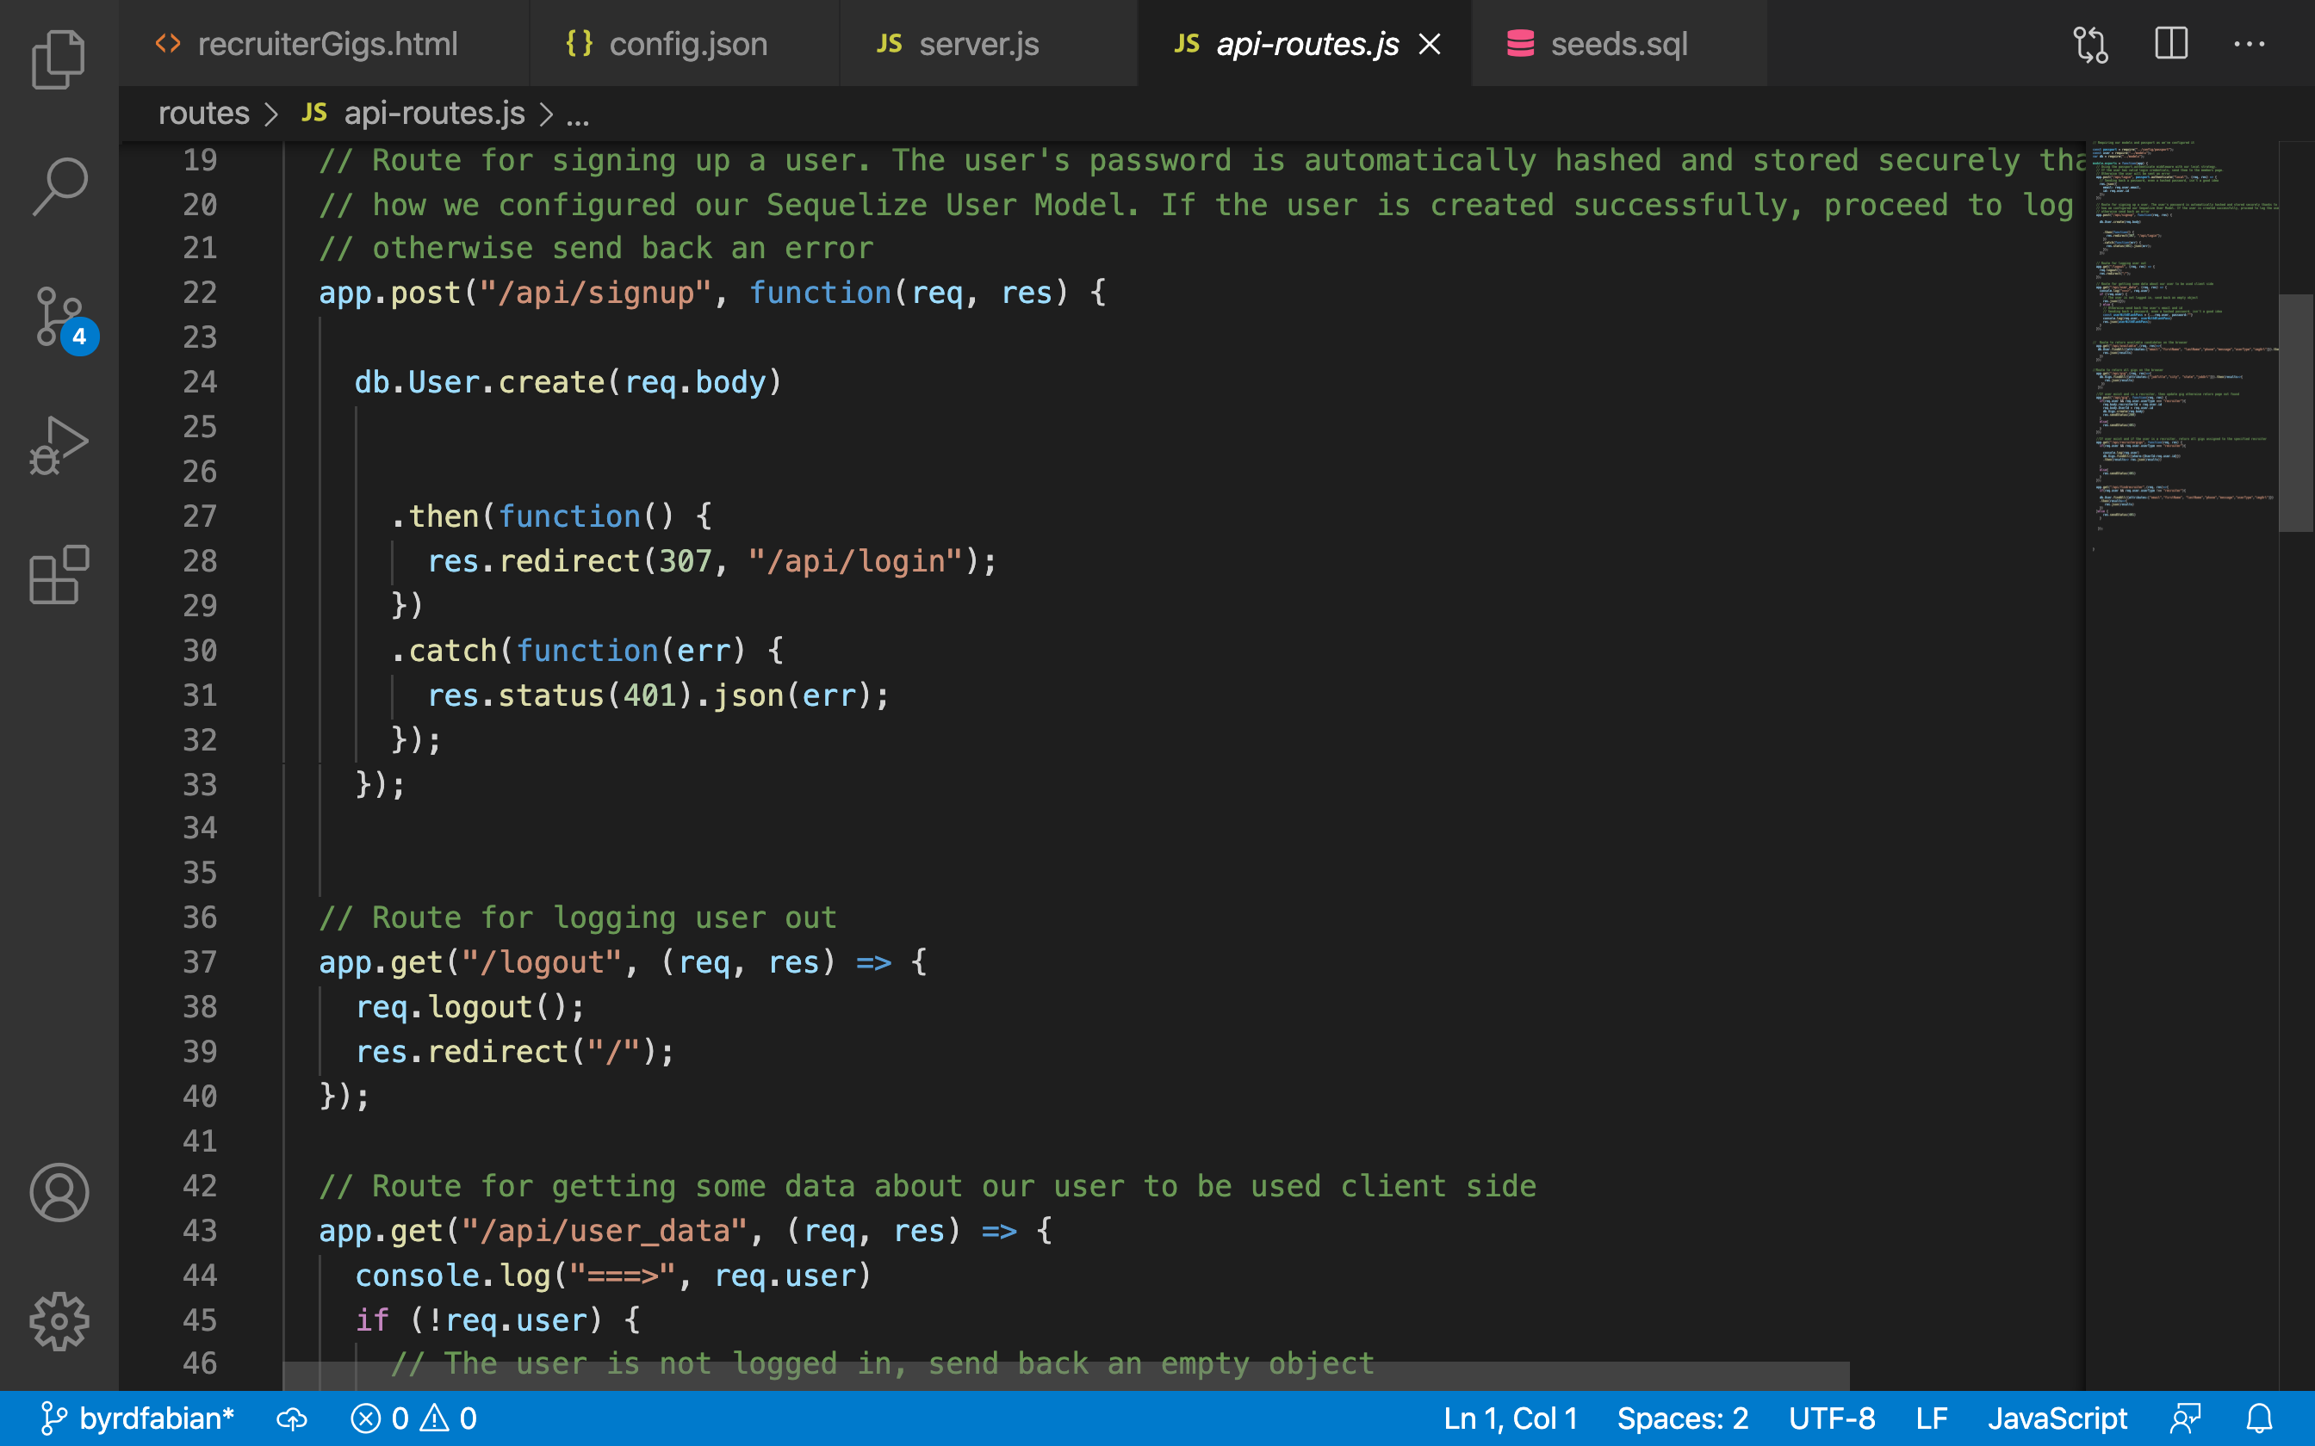
Get & Post Routes
Notes:
To illustrate the use of Get and Post we’ve included a screenshot of our code related to signup and logout functions.

Slide 11
Future Features
Ability for students and recruiters to update their profile.
Conversion to Express Handlebars ( {{ }} ).
Call button to initiate a call to a student/recent graduate.
Ability for student to upload their most up-to-date resume.
Notes:
Future features include:
The ability for students and recruiters to update their profile.
Conversion to Express Handlebars ( {{ }} ).
A call button to initiate a call to a student/recent graduate.
The ability for student to upload their most up-to-date resume.

Slide 12
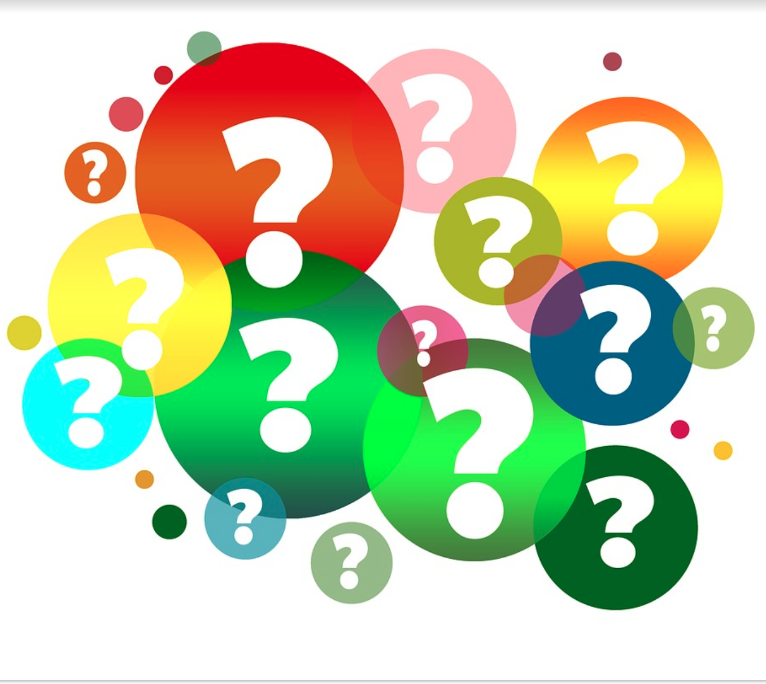

Slide 13
Demonstration
Application URL/hyperlink

